Slide 1
Lab
Yijun
7/9

Slide 2
Lab Topics
Item-based Collaborative Filtering Recommendation System
Yelp Datasets Introduction (7/8)
Pearson Correlation (7/8)
Weighted Average for Prediction (7/9)
Model Evaluation (7/9)
Spatial Data Visualization
QGIS Tutorial (7/8)
Visualization with Yelp Datasets (7/9)
Spatial Computing using QGIS (7/9)

Slide 3
Lab Tasks (7/9)
Continue your recommendation system
Implement the functions to compute weighted average as the prediction result
Set up QGIS environment
Add multiple layers for visualization
Vector data
Shape files
Spatial join and statistic analysis

Slide 4

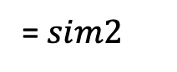
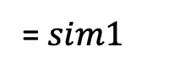
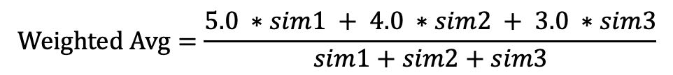
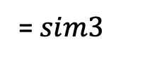
Review: Weighed Average
Item-based Collaborative Filtering Recommendation System
(
)
Similarity
= $sim1$
(
)
Similarity
= $sim2$
(
)
Similarity
= $sim3$
5.0
3.0
4.0
$$Weighted Avg=\frac{5.0 ∗sim1 + 4.0 ∗sim2 + 3.0 ∗sim3}{sim1+sim2+sim3}$$

Slide 5
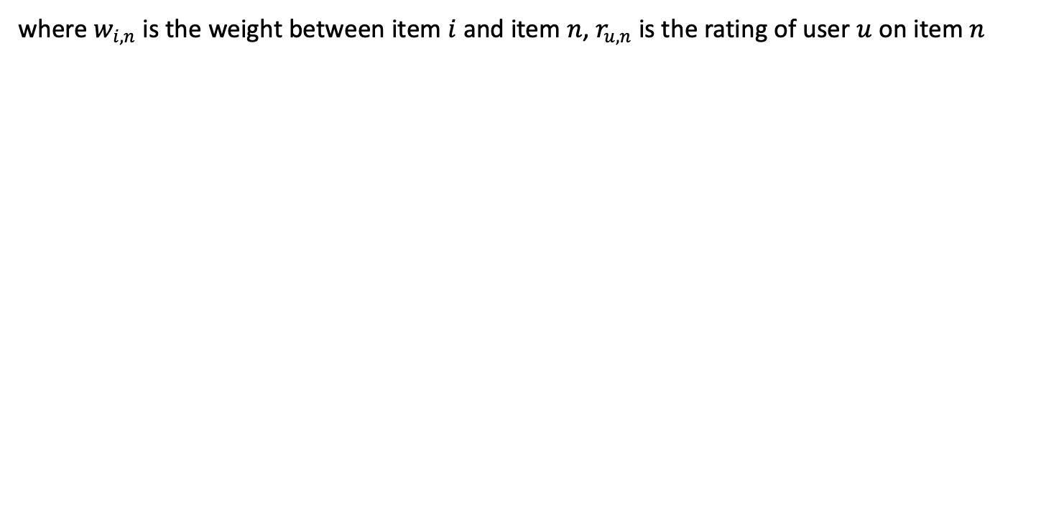
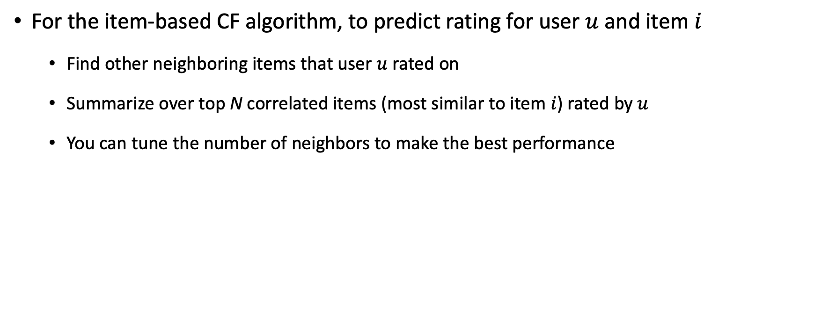
Review: Weighed Average
For the item-based CF algorithm, to predict rating for user $u$ and item $i$
Find other neighboring items that user $u$ rated on
Summarize over top N correlated items (most similar to item $i$) rated by $u$
You can tune the number of neighbors to make the best performance
where $w_{i,n}$ is the weight between item $i$ and item $n$, $r_{u,n}$ is the rating of user $u$ on item $n$

Slide 6
Continue Your Recommendation System…
Git clone the repository: https://github.com/linyijun/lab201907.git
Follow the Tutorial <recommendation_system_tutorial _part_2.docx>

Slide 7
Spatial Data Visualization
Spatial Data
Points, Lines, Polygons, …
QGIS
A Free and Open Source Geographic Information System
Can visualize different types of spatial data, e.g., shapefile, CSV file.

Slide 8
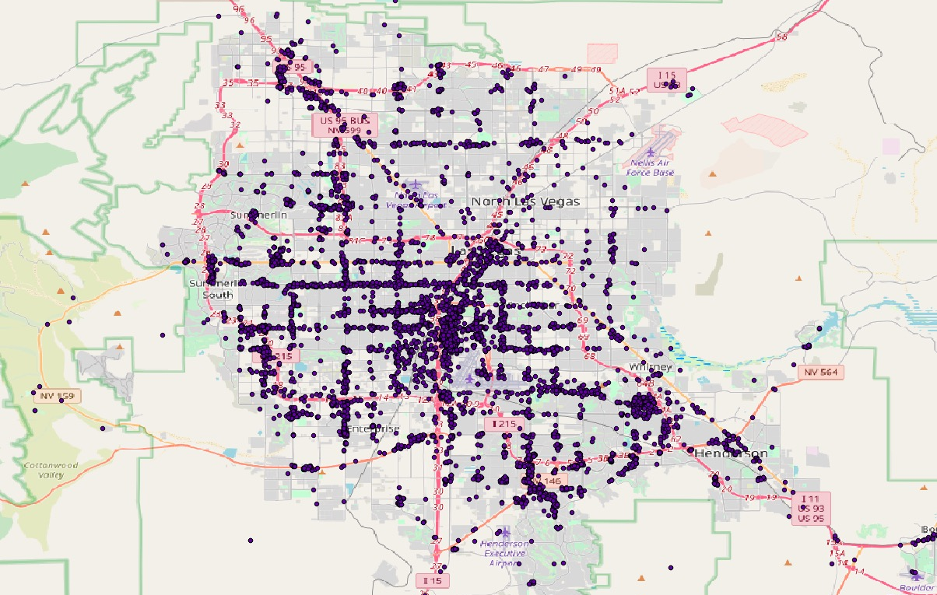
Spatial Data Visualization
Visualize Yelp business locations on the OpenStreetMap
Follow the Tutorial <QGIS_tutorial.docx>

Slide 9
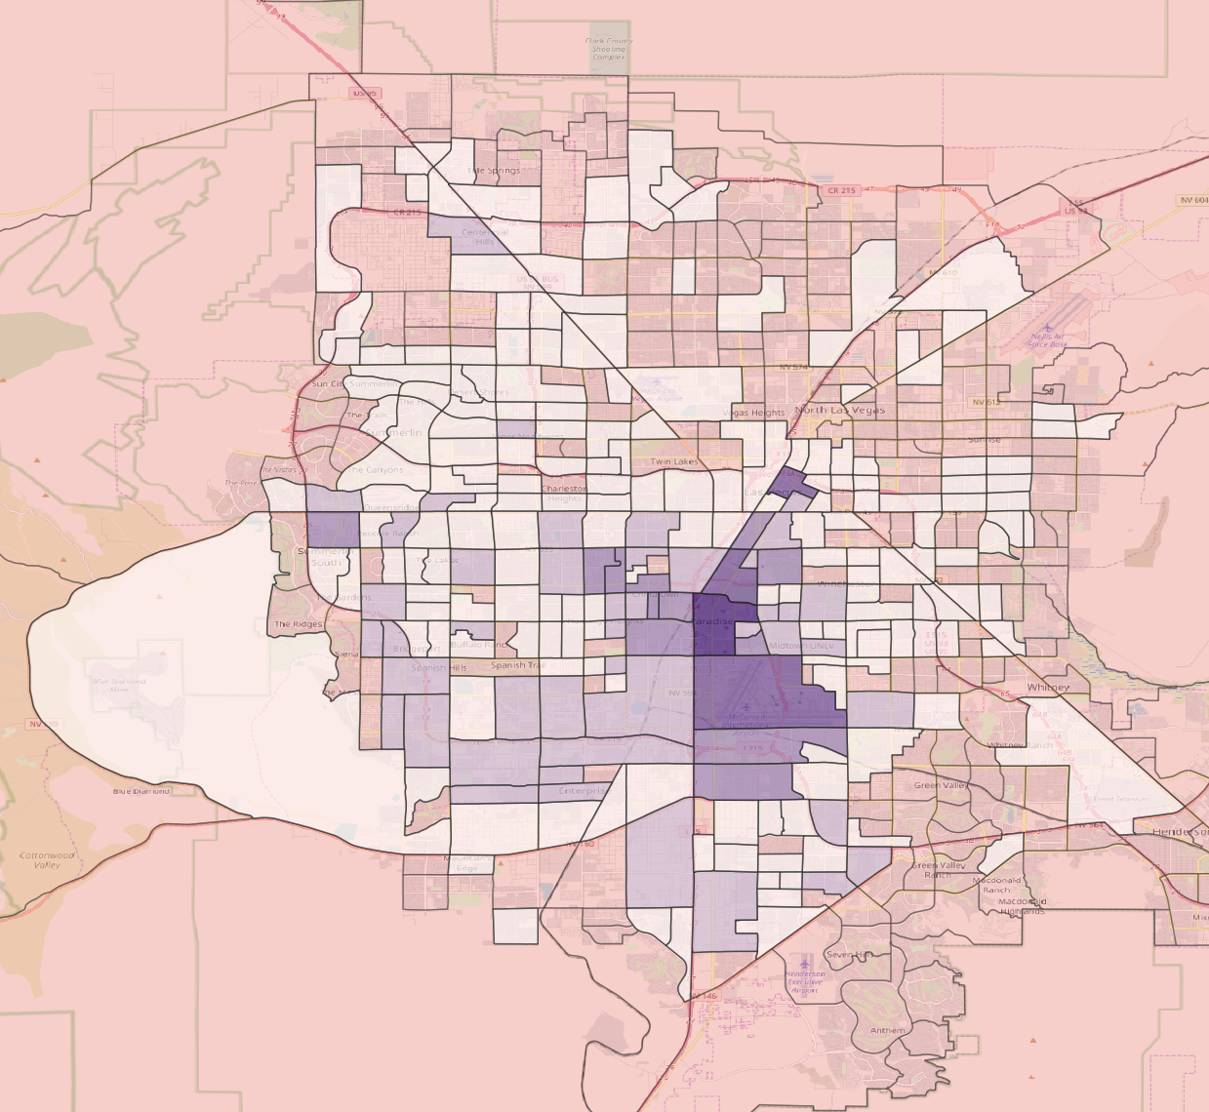
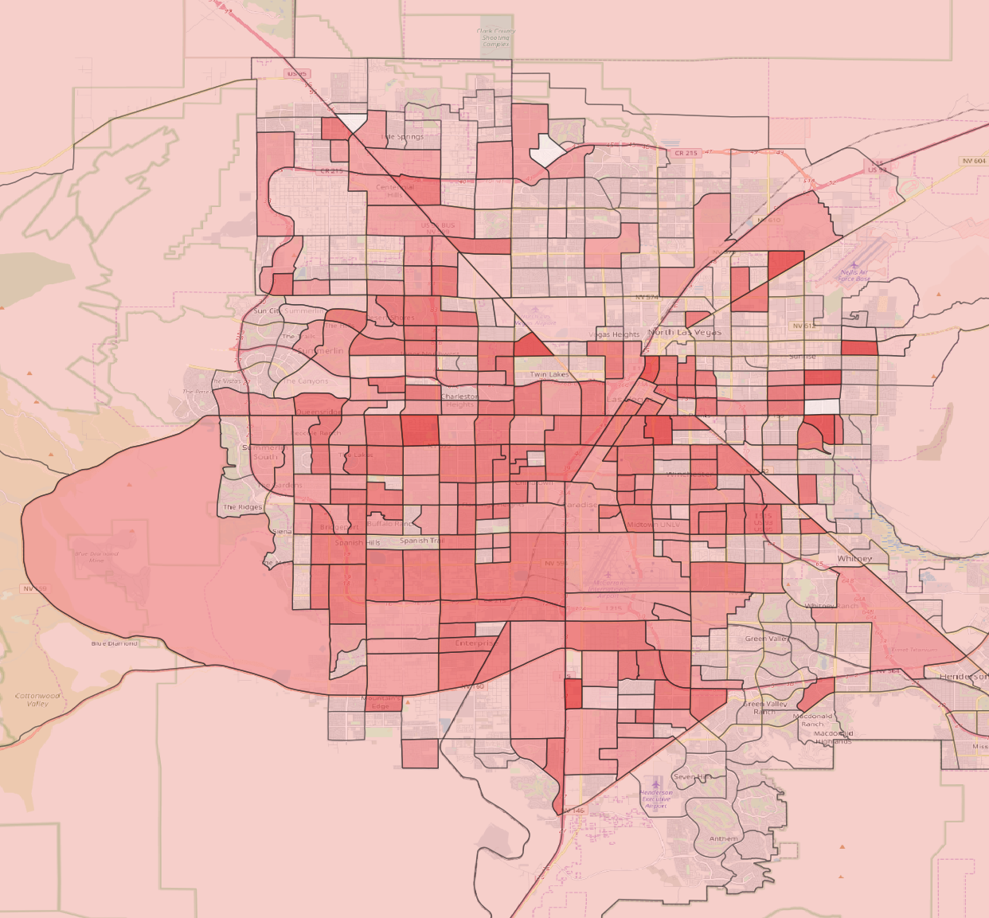
Spatial Data Visualization
Visualize statistic summarization of review data on Census Tract
Follow the Tutorial <QGIS_tutorial.docx>

